Slide 1
DISASTER ASSESSMENT SYSTEM FOR DRONES

Slide 2
OUR TEAM
SHREYA CHOPRA
KUNAL DEMLA
SINISTER REWIND

Slide 3
THE PROBLEM
CHALLENGES
Damage assessment is essential for evacuation and restoration plans in a natural disaster. Decisiveness and precision are required to perform tasks at their maximum efficiency. The analysis plays a vital role in the evacuation of survivors. The information further helps conserve significant buildings and resources that can be retrieved from the destroyed site. Natural disasters cause significant damage to transportation and
communication networks, making it difficult for assessment teams to reach affected areas. Furthermore, gathering accurate and reliable data during a disaster can be challenging, especially in areas where data-collecting bodies have also been
damaged. In case of a disaster, different organizations and countries may use other methods for disaster assessment, making it difficult to compare results and coordinate
a response. These restraints provide an opportunity to present and build a more efficient system for disaster assessment.
Notes:
Damage assessment is essential for evacuation and restoration plans in a natural
disaster. Decisiveness and precision are required to perform tasks at their maximum efficiency.
The analysis plays a vital role in the evacuation of survivors. The information
further helps conserve significant buildings and resources that can be retrieved from the
destroyed site.. Natural disasters cause significant damage to transportation and
communication networks, making it difficult for assessment teams to reach affected areas.
Furthermore, gathering accurate and reliable data during a disaster
can be challenging, especially in areas where data-collecting bodies have also been
damaged. In case of a disaster, different organizations and countries may use other
methods for disaster assessment, making it difficult to compare results and coordinate
a response. These restraints provide an opportunity to present and build a more efficient system
for disaster assessment.

Slide 4
OUR SOLUTION
We have built a disaster assessment system for drones that lets the relief team control the drone and capture images. These images are encrypted and saved on a microcontroller attached to the drone. The encrypted images will be decrypted when the microcontroller comes back to the base station where super resolution will be applied on the decrypted images for image quality enhancement. Finally, a disaster assessment report will be generated for the images to indicate the extent of the damage to the structures.
We have built a disaster assessment system for drones that lets the relief team control the drone and capture images. These images are encrypted and saved on a microcontroller attached to the drone. The encrypted images will be decrypted when the microcontroller comes back to the base station where super resolution will be applied on the decrypted images for image quality enhancement. Finally, a disaster assessment report will be generated for the images to indicate the extent of the damage to the structures.

Slide 5
FEATURES
REAL TIME CONTROL
ENCRYPTION
SUPER RESOLUTION
ANALYSIS REPORT
The drone’s movement can be controlled in real time
The images will be encrypted on the microcontroller
To enhance image quality for better assessment
Indicating the extent of damage to buildings and structures

Slide 6
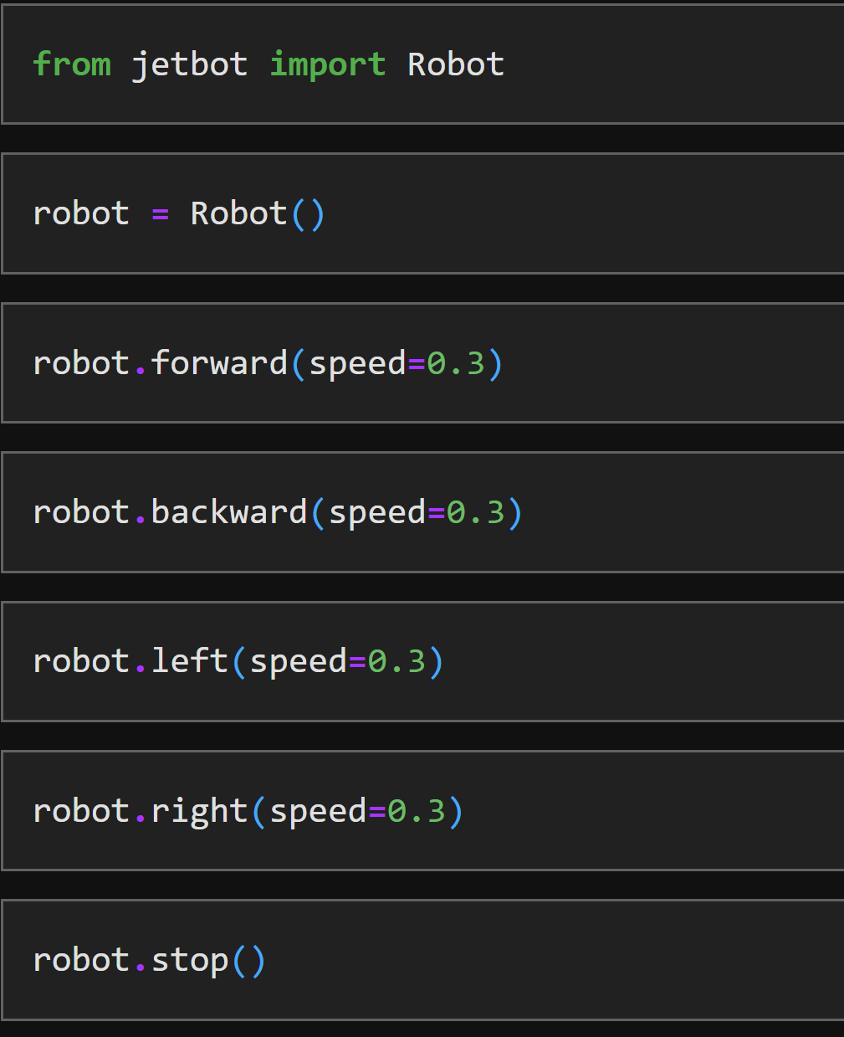
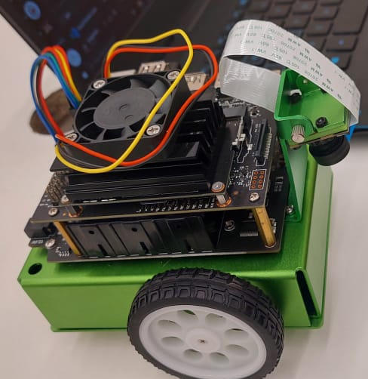
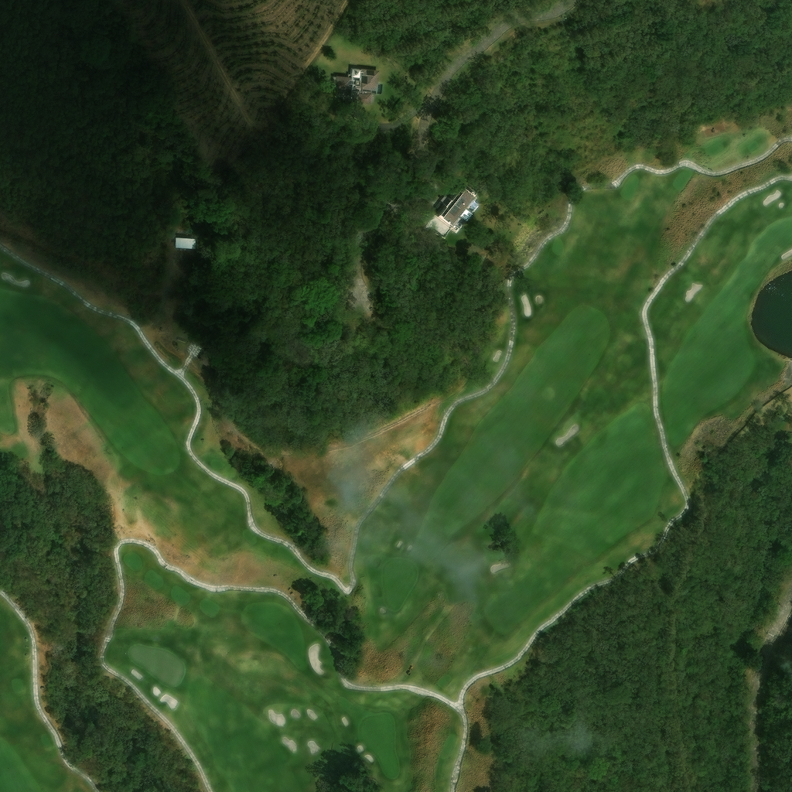
DRONE CONTROL
The drone will be controlled in real time using a Jetson Nano microcontroller
User can save images when desired and the images will be encrypted simultaneously
SAVE
COUNT: 1

Slide 7

ENCRYPTION
The encryption algorithm is based on Rubik’s cube and uses a Lorenz map to generate the encryption key.
Original Image
Encrypted Image

Slide 8
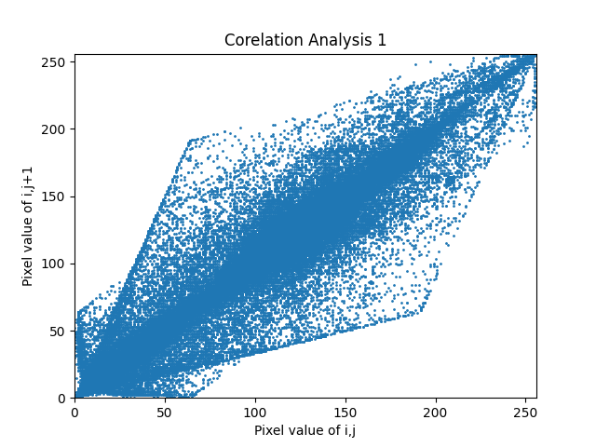
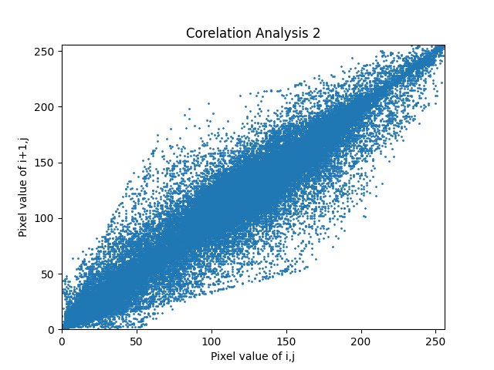
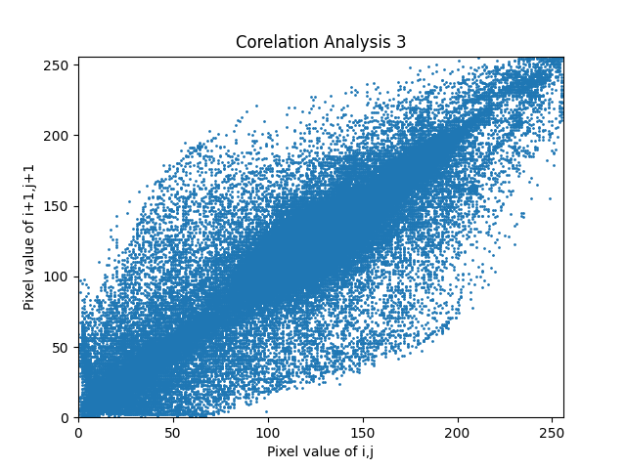
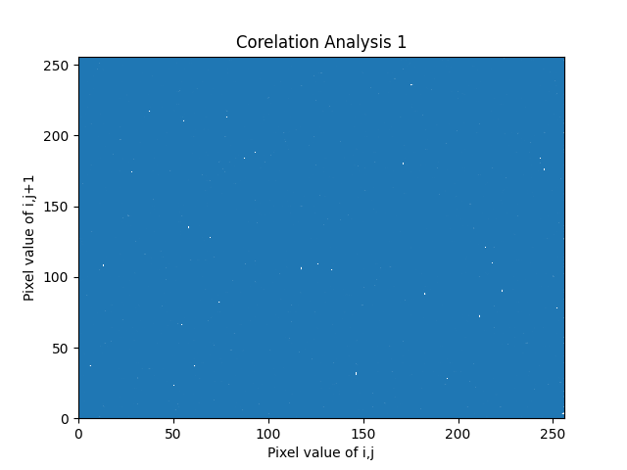

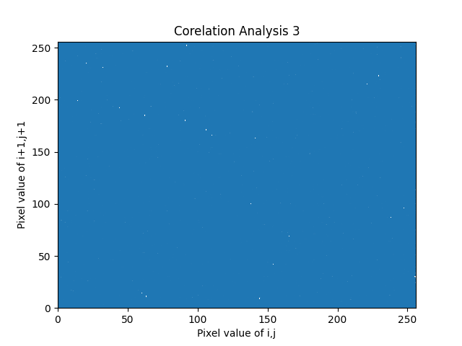
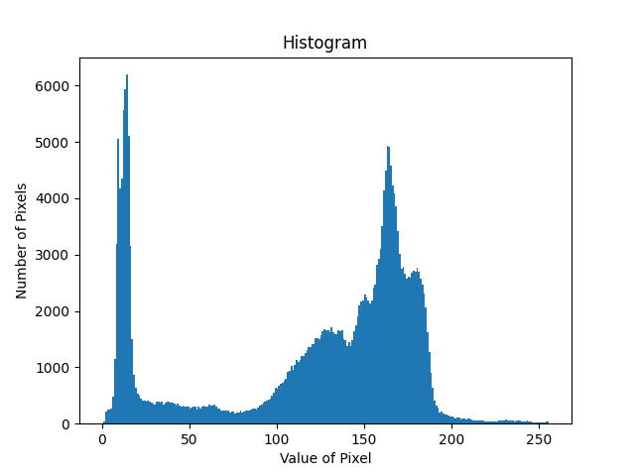
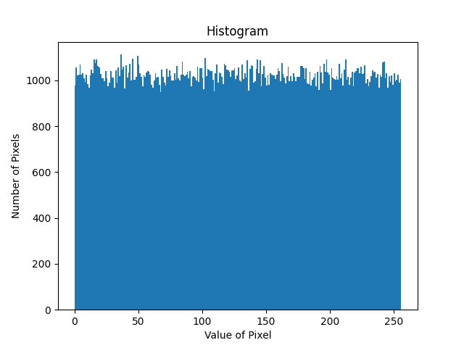
ENCRYPTION EVALUATION METRICS
Average UACI=49.84
Average NPCR=99.75

Slide 9
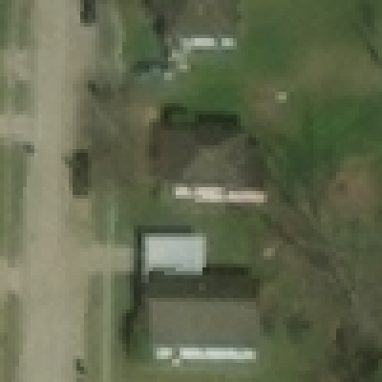

SUPER RESOLUTION
The super resolution algorithm is based on GAN and RRDN. The image’s resolution changes to 4 times the original resolution.
Original Image
Enhanced Image

Slide 10
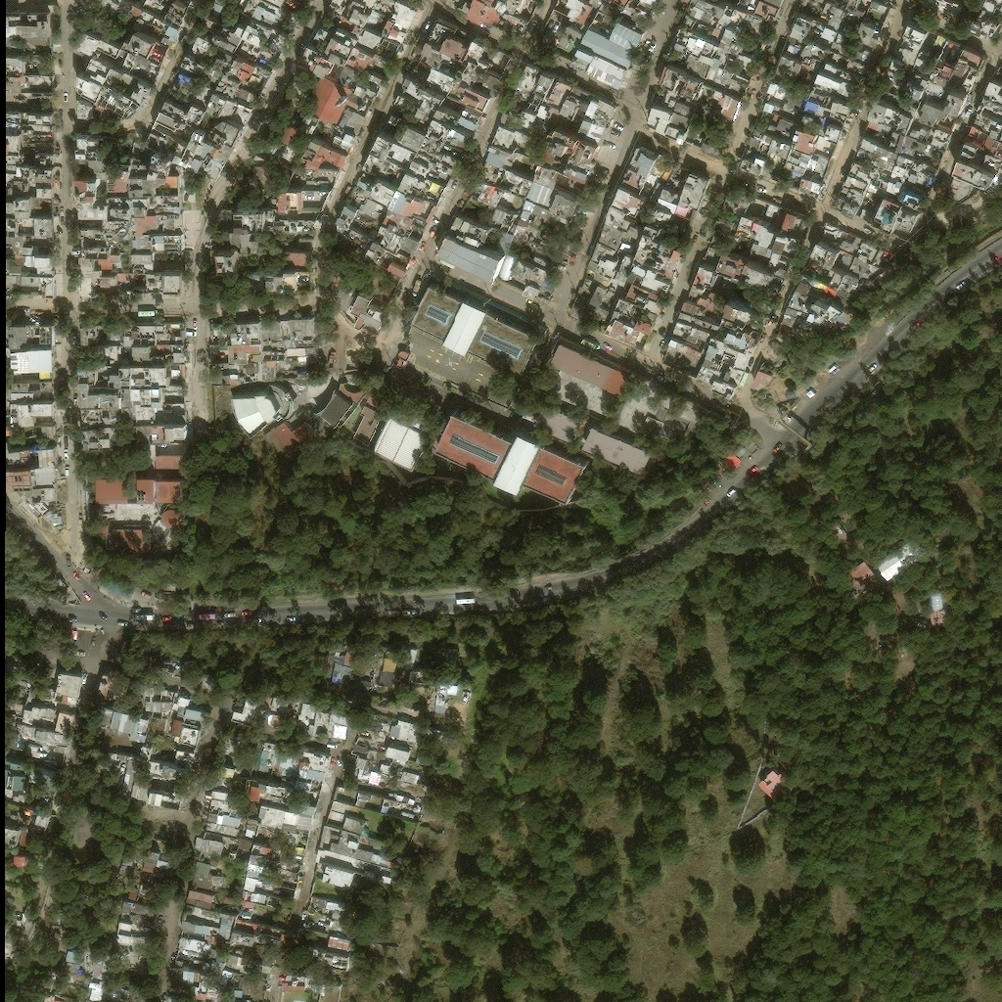
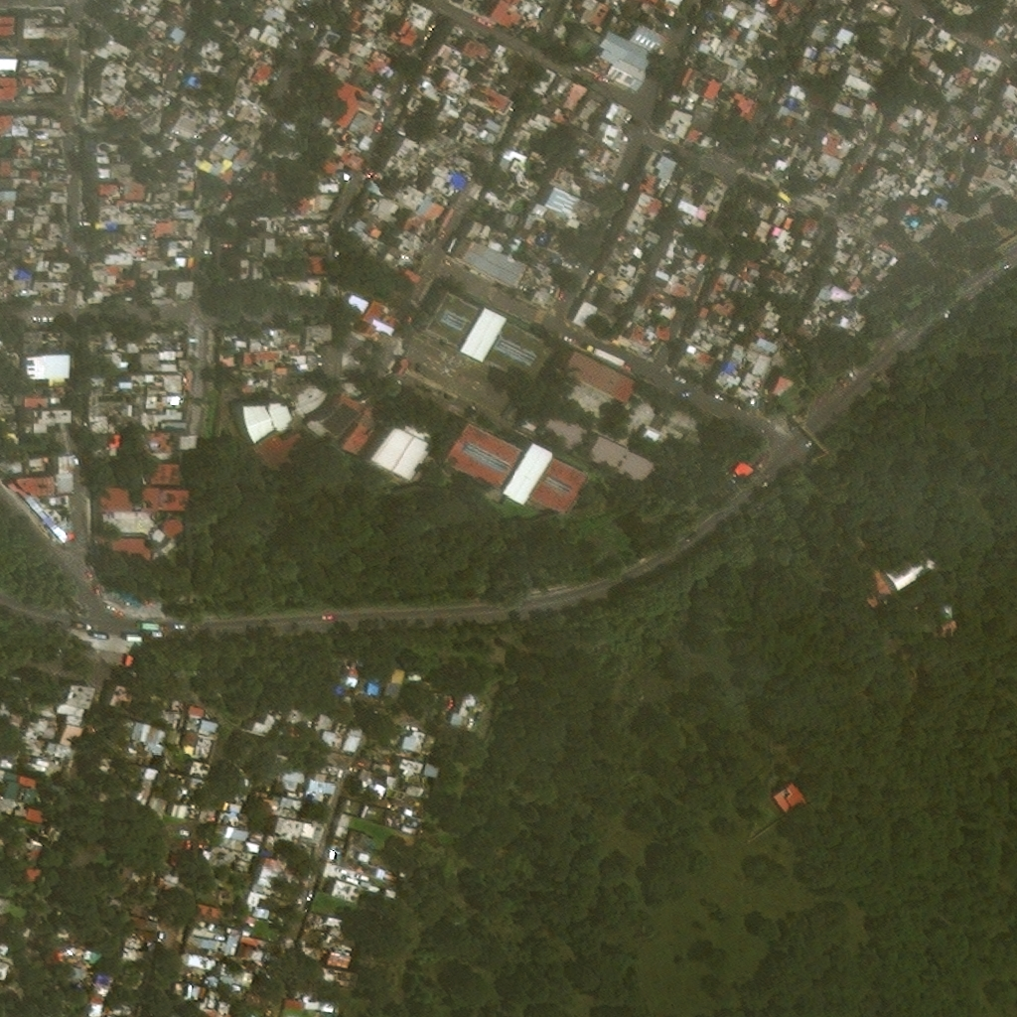
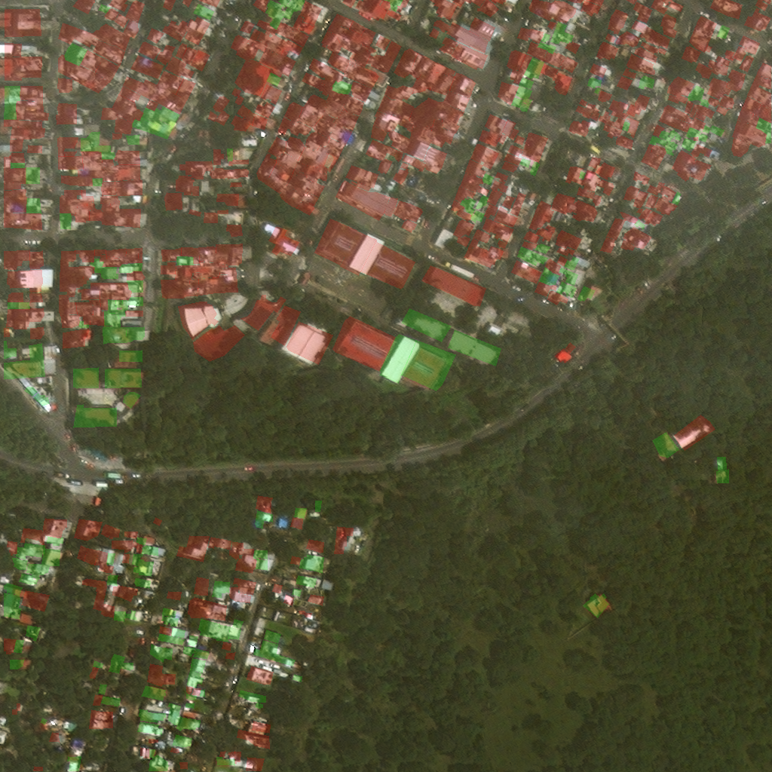
DAMAGE ASSESSMENT MODEL
The model generates a disaster analysis report on a user-friendly portal.
Pre disaster Image
Post Disaster Image
Annotated Image

Slide 11
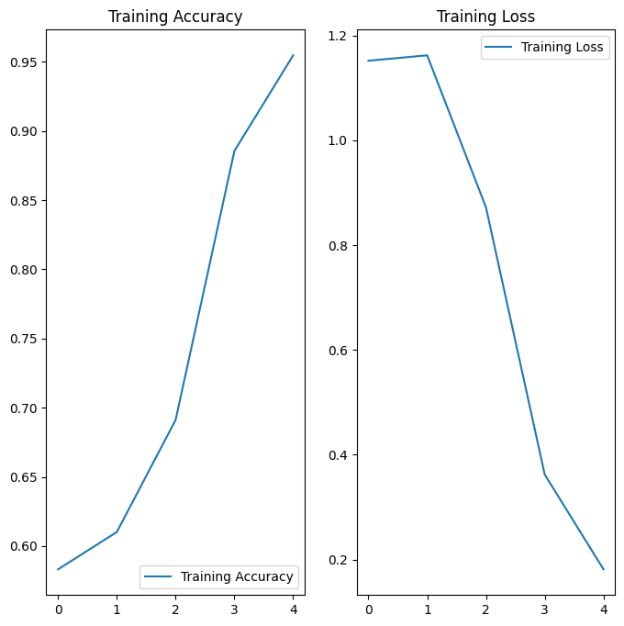
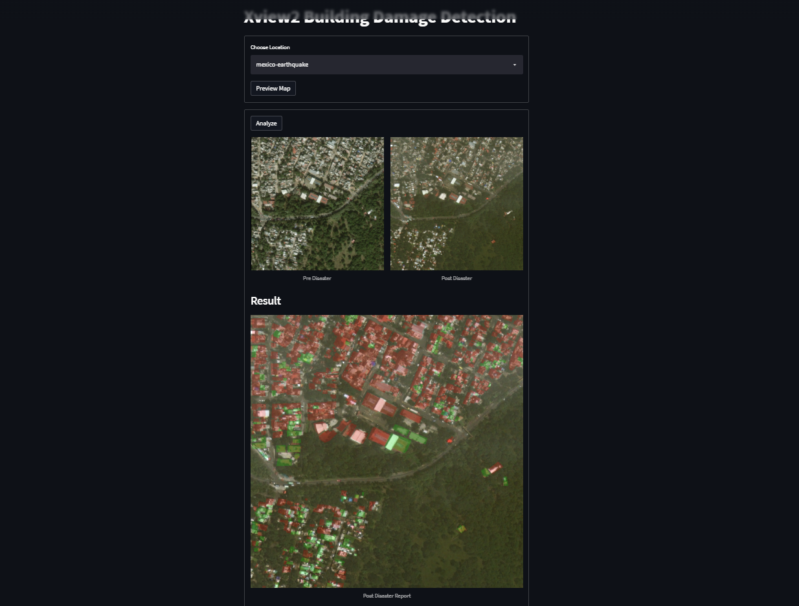
MODEL EVALUATION METRICS AND PORTAL
We have created a self trained model on the xview2 challenge dataset. We achieved an accuracy of 95.46%. The report generated is available on a user friendly portal

Slide 12
TECH STACKS USED
ML/DL
CYBER SECURITY
IMAGE PROCESSING
INTERNET OF THINGS
WEB DEVELOPMENT & STREAMLIT
JETBOT AND JETSON NANO PROGRAMMING
DOCKER

Slide 13
FUTURE SCOPE
SITE MAPPING
EVACUATION ROUTES
THERMAL IMAGERY

Slide 14
-Adam Lisberg
“In the aftermath of a disaster, drone technology can help us assess damage, map affected areas, and locate survivors with greater speed and efficiency.”

Slide 15
THANK YOU!

